Slide 1
Mutant huntingtin causes defective actin remodeling during stress: defining a new role for transglutaminase 2 in neurodegenerative disease
Lise Munsie¹, Nicholas Caron¹, Randy Singh Atwal¹, Ian Marsden², Edward J. Wild³, James R. Bamburg², Sarah J. Tabrizi³, and Ray Truant^{1•}
¹Department of Biochemistry and Biomedical Sciences, McMaster University, 1200 Main Street West, Hamilton, Ontario, Canada L8N3Z5,
²Department of Biochemistry and Molecular Biology, Colorado State University, Fort Collins, CO 80523-1870, USA and
³Department of Neurodegenerative Disease, UCL Institute of Neurology, National Hospital for Neurology and Neurosurgery, Queen Square, London WC1N 1NG, UK
Presentation By: Jaclyn Nguyen, BIOL 506 Human Molecular Genetics, Fall 2011

Slide 2
Outline
Introduction to Huntington’s Disease (HD)
Stress response
Results Overview
Implications of their work
Future Work / Reflection

Slide 3
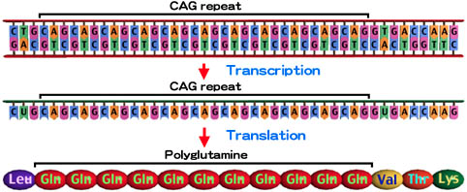
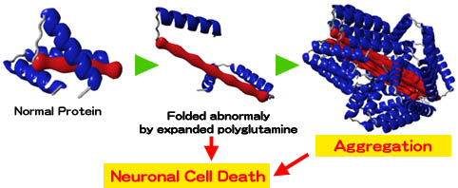
Huntington’s Disease (HD)
http://www.brain.riken.jp/labs/cagrds/CAG2_e.html
Notes:
The causative CAG repeat is present in the coding region of the interesting transcript 15 (IT15), which encodes the amino acid sequence of the H protein. And, CAG is the code for an amino acid, glutamine. If the elongated CAG repeat is translated, it generates a protein with an expanded glutamine (polyglutamine) tract. This polyglutamine tract has a toxic effect on the cell.
What happens when the polyglutamine tract expands?
Protein must be folded correctly for its normal function. However, if the polyglutamine tract is expanded, the folding of this protein will not be normal. This unusual protein can aggregate, eventually leading to neuronal cell death.

Slide 4
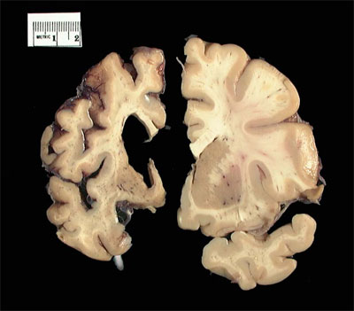
Huntington’s Disease (HD)
http://neuroskeptic.blogspot.com/2010/10/cannabinoids-in-huntingtons-disease.html
Notes:
Progressive neurodegenerative disorder usually late-onset

Slide 5
Huntington’s Disease (HD)
Normal functions of Huntington Protein
  Transcriptional regulation
  Epigenetic control
  Vesicle trafficking
  Endoplasmic reticulum (ER)-stress response
  Neurogenesis during development
Notes:
The overall goal of the authors was to study normal huntington cell biology under transient stresses similar to stresses that occur with normal human aging

Slide 6
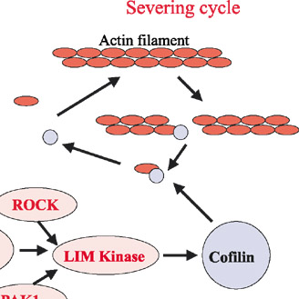
Cofilin-Acting Pathway
Cofilin rods + ATP
http://www.antibodyreview.com/article_images/12049672/Genome%20Biol/3-5/previews3007.1-139363/gb-2002-3-5-reviews3007-4.jpg
Notes:
Actin treadmilling = cell motility
Neuronal motility relies on actin treadmilling. In addition to regulating cytoskeletal dynamics in the cytoplasm, actin modulates nuclear gene expression.
Explain the normal response
Cofilin = actin binding protein

Slide 7
Results Overview
Is huntington protein involved in the cellular response?
Huntington protein can localize on other non-neuron-derived cells and cofilin-actin rods persist after the cellular response is over.
Knockdown of normal huntington protein mimicks mutant huntington protein cellular response.
Trapped cofilin-actin complexes increase with severity of HD.
Transglutaminase (TG2) is involved in cofilin-actin crosslinking.
Notes:
The overall goal of the authors was to study normal huntington cell biology under transient stresses similar to stresses that occur with normal human aging

Slide 8
Wild Type STHdh^{Q7/Q7}
Mutant STHdh^{Q111/Q111}

Slide 9
Results Overview
Huntington protein localizes to cofilin-actin rods under cellular stress.
Can huntington localize to other non-neuron derived cells and does impaired response persist like in Alzheimer’s Disease?
Knockdown of normal huntington protein mimicks mutant huntington protein cellular response.
Trapped cofilin-actin complexes increase with severity of HD.
Transglutaminase (TG2) is involved in cofilin-actin crosslinking.
Notes:
The overall goal of the authors was to study normal huntington cell biology under transient stresses similar to stresses that occur with normal human aging

Slide 11
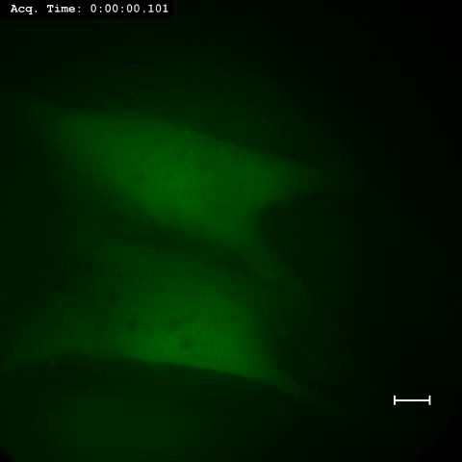
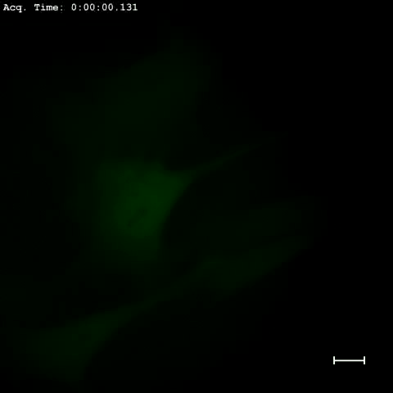
Wild Type STHdh^{Q7/Q7}
Mutant STHdh^{Q111/Q111}
Notes:
http://hmg.oxfordjournals.org/content/suppl/2011/02/23/ddr075.DC1/ddr075supp_video1.mov
http://hmg.oxfordjournals.org/content/suppl/2011/02/23/ddr075.DC1/ddr075supp_video2.mov

Slide 12
Results Overview
Huntington protein localizes to cofilin-actin rods under cellular stress.
Huntington protein can localize on other non-neuron-derived cells and cofilin-actin rods persist after the cellular response is over.
What happens if normal huntington protein expression is knocked down? (Confirmation for 2).
Trapped cofilin-actin complexes increase with severity of HD.
Transglutaminase (TG2) is involved in cofilin-actin crosslinking.
Notes:
The overall goal of the authors was to study normal huntington cell biology under transient stresses similar to stresses that occur with normal human aging

Slide 13
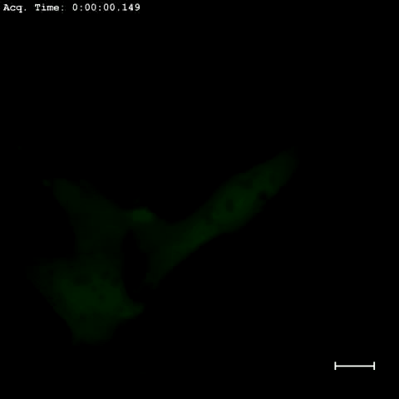
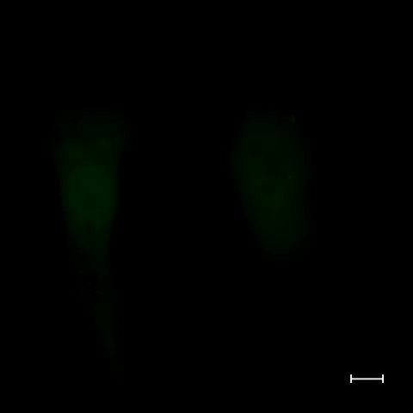
STHdh^{Q7/Q7} with siRNA control
STHdh^{Q7/Q7} with huntington specific siRNA

Slide 14
Results Overview
Huntington protein localizes to cofilin-actin rods under cellular stress.
Huntington protein can localize on other non-neuron-derived cells and cofilin-actin rods persist after the cellular response is over.
Knockdown of normal huntington protein with siRNA mimicks mutant huntington protein cellular response.
Where is free cofilin going if it’s not forming numerous rods?
Transglutaminase (TG2) is involved in cofilin-actin crosslinking.
Notes:
The overall goal of the authors was to study normal huntington cell biology under transient stresses similar to stresses that occur with normal human aging

Slide 16
Results Overview
Huntington protein localizes to cofilin-actin rods under cellular stress.
Huntington protein can localize on other non-neuron-derived cells and cofilin-actin rods persist after the cellular response is over.
Knockdown of normal huntington protein mimicks mutant huntington protein cellular response.
Trapped cofilin-actin complexes increase with severity of HD.
What is contributing to the cross-linking of cofilin and actin (thus eating up free cofilin)?
Notes:
The overall goal of the authors was to study normal huntington cell biology under transient stresses similar to stresses that occur with normal human aging

Slide 19
Results Overview
Huntington protein localizes to cofilin-actin rods under cellular stress.
Huntington protein can localize on other non-neuron-derived cells and cofilin-actin rods persist after the cellular response is over.
Knockdown of normal huntington protein mimicks mutant huntington protein cellular response.
Trapped cofilin-actin complexes increase with severity of HD.
Transglutaminase (TG2) is involved in cofilin-actin crosslinking.
Notes:
The overall goal of the authors was to study normal huntington cell biology under transient stresses similar to stresses that occur with normal human aging

Slide 21
Implications
New therapeutic targets for HD
  Inhibition of TG2 activity (by Ca modulation?)
  Alternative pathways?
  New biomarker for HD: free cofilin to complexed cofilin ratio
Notes:
The overall goal of the authors was to study normal huntington cell biology under transient stresses similar to stresses that occur with normal human aging

Slide 22
Future Work
Controlling TG2 activity with Ca levels
Inhibiting TG2 activity with other substrates
Exact role of huntington protein during cell response?
Experiments should include more HD patient samples
Notes:
The overall goal of the authors was to study normal huntington cell biology under transient stresses similar to stresses that occur with normal human aging

Slide 23

Questions?
Notes:
The overall goal of the authors was to study normal huntington cell biology under transient stresses similar to stresses that occur with normal human aging

